Slide 1

A Global World
Using Data Science to Make More Informed Decisions

Slide 2

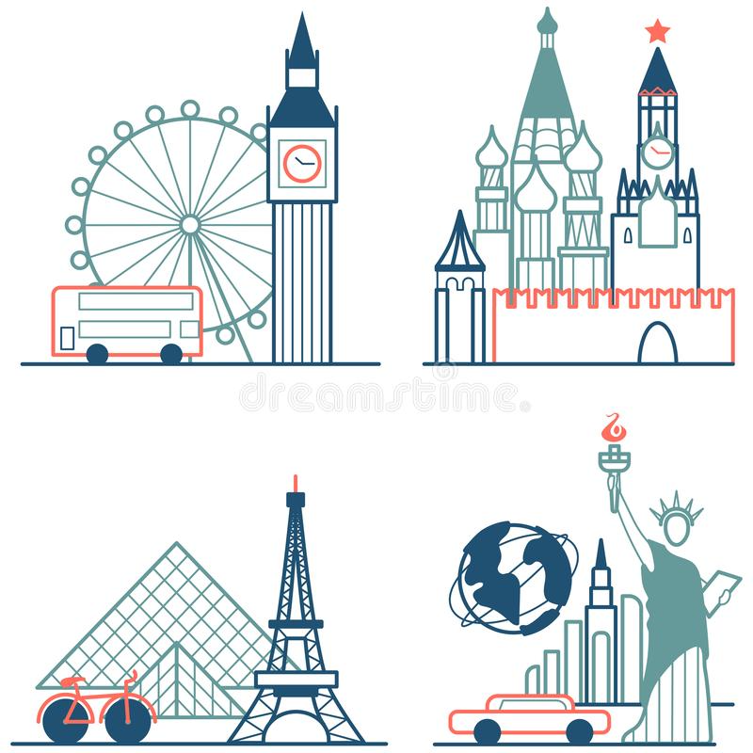

PROBLEM
An employee must move from New York City to London to take on a new role at her company. She wants to live in a neighborhood that offers many of the same amenities as her hometown

Slide 3
DATA SOURCES
New York City data set from NYU
London data set from Wikipedia
Venue data from Foursquare API

Slide 4
METHODOLOGY

Slide 5
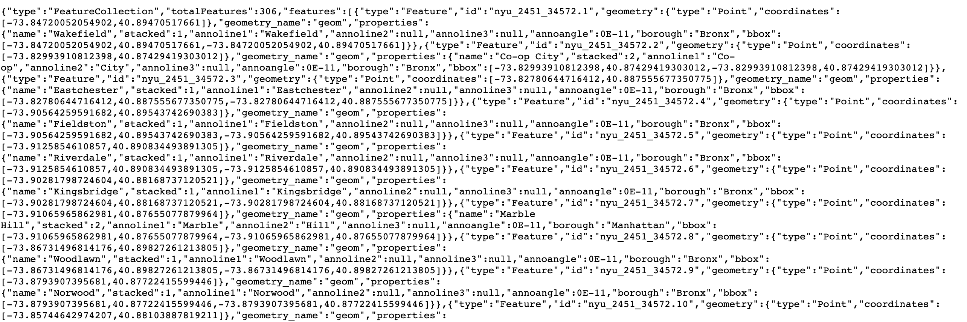
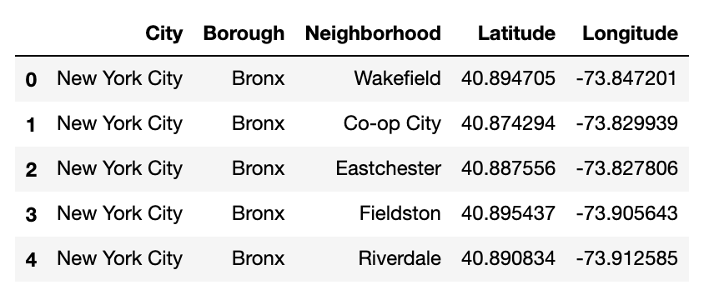
TRANSFORMING NYC DATA
JSON File
Data Frame

Slide 6
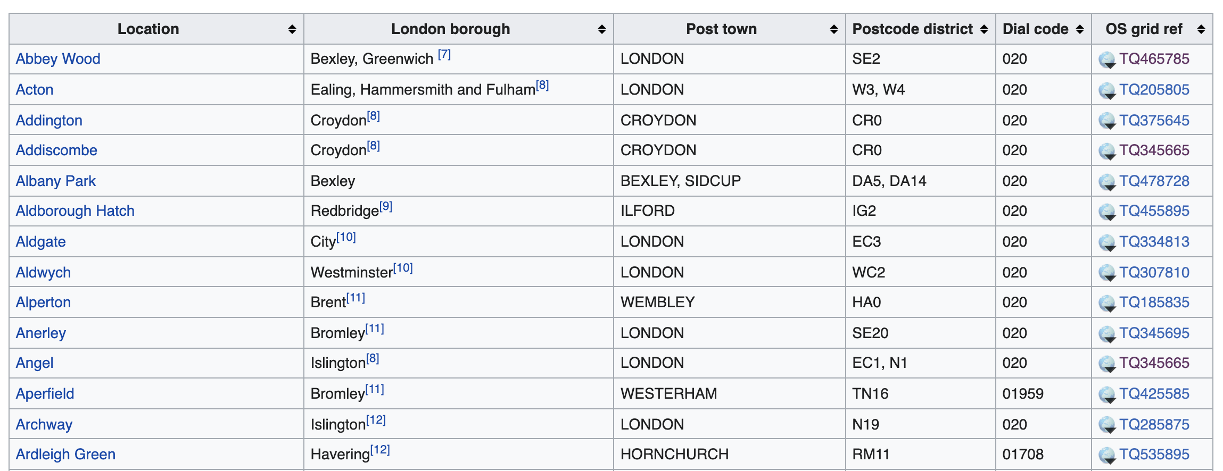
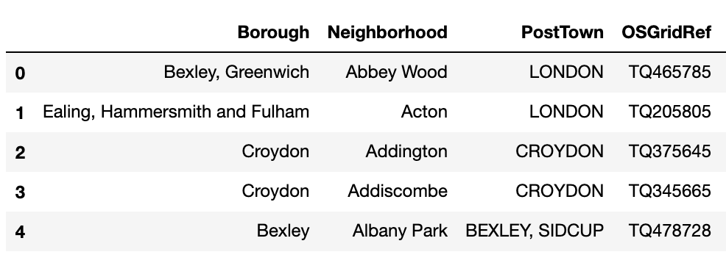
TRANSFORMING LONDON DATA
Wikipedia Page
Data Frame

Slide 7
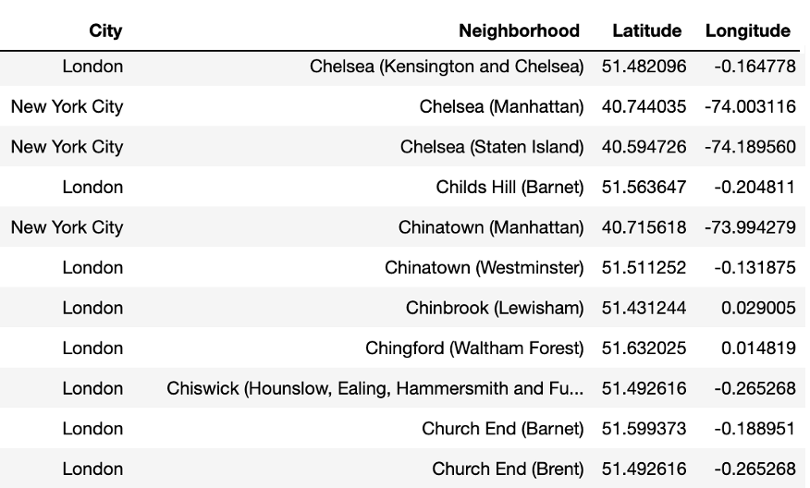
MERGING DATA

Slide 8
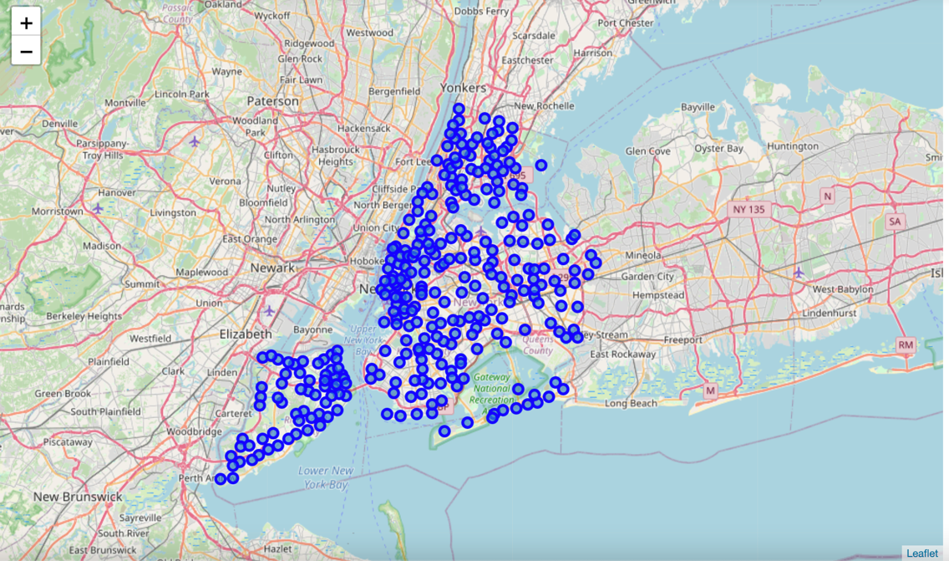
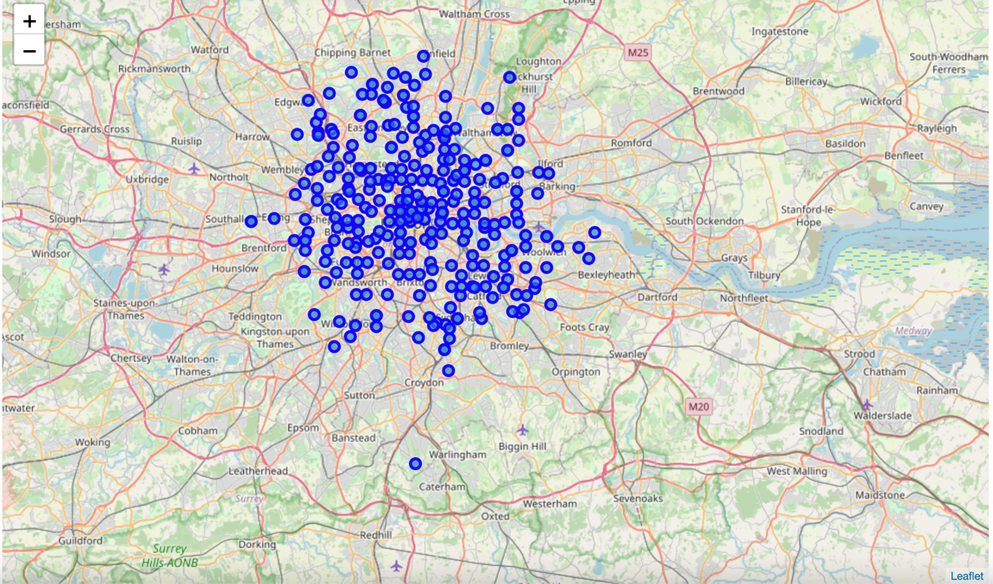
MAPPING NEIGHBORHOODS
Map of New York City
Map of London

Slide 9
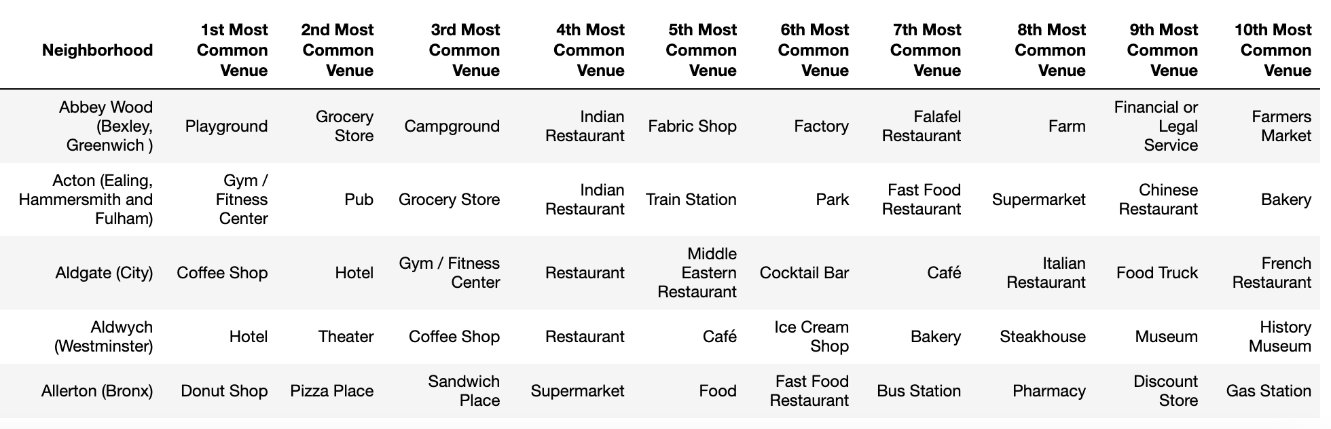
TOP VENUES BY NEIGHBORHOOD

Slide 10
RESULTS

Slide 11
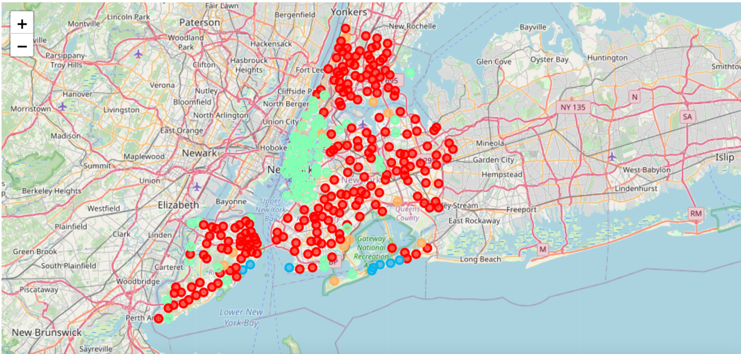
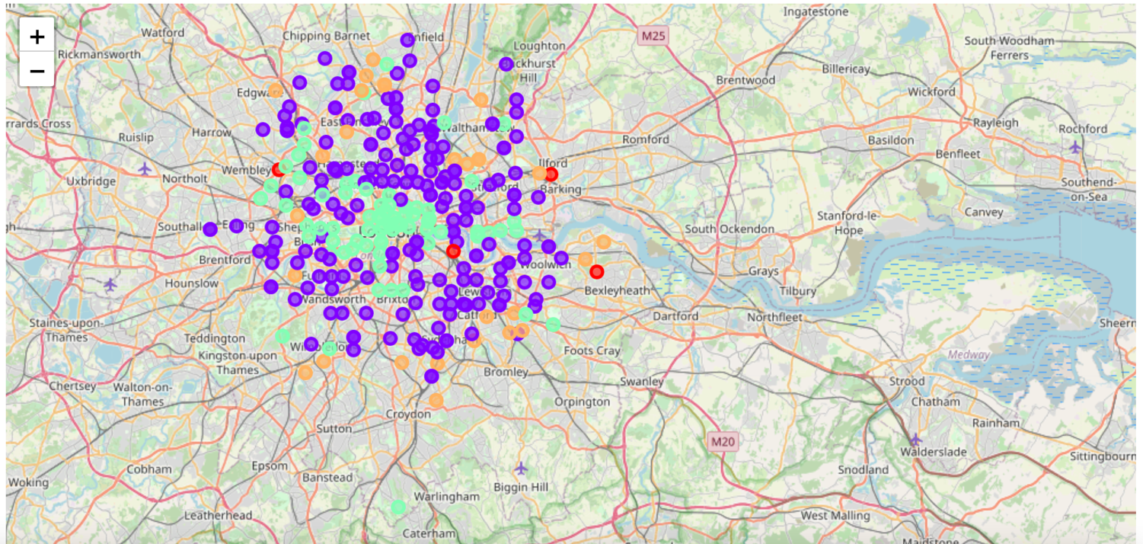
MAPPING CLUSTERS
Cluster Map of New York City
Cluster Map of London

Slide 12
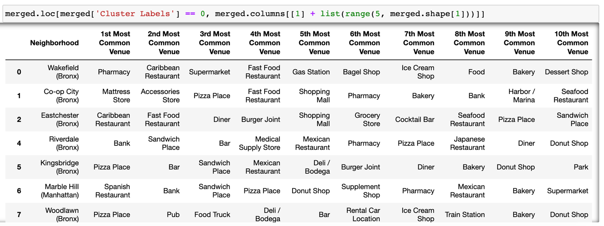
RED CLUSTER (0)
Pizza Places, Delis/Bodegas & Pharmacies

Slide 13
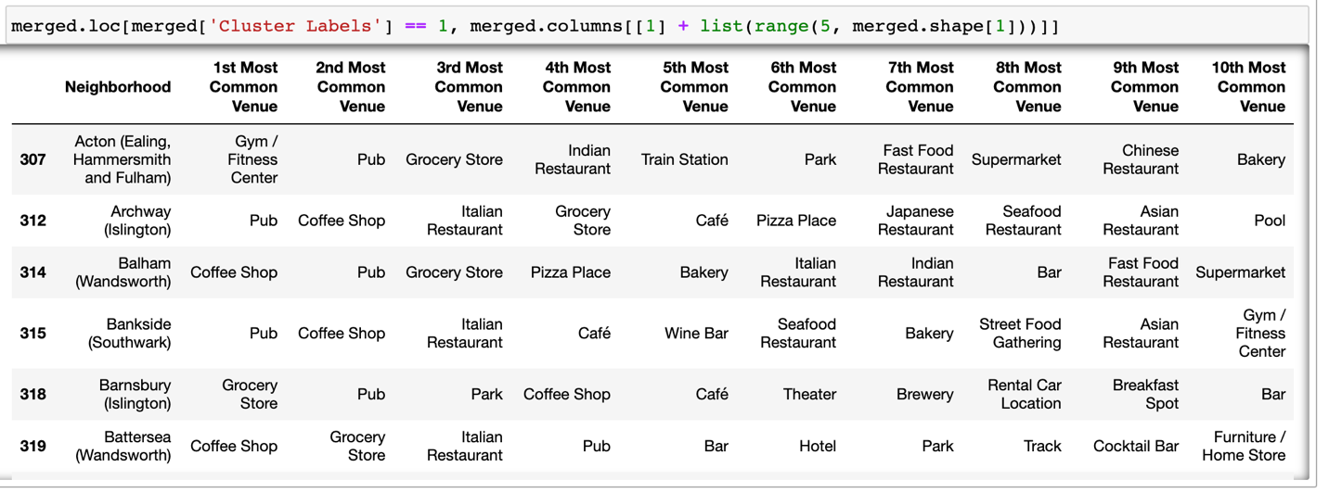
PURPLE CLUSTER (1)
Pubs, Cafés, Coffee Shops, Grocery Stores & Parks

Slide 14
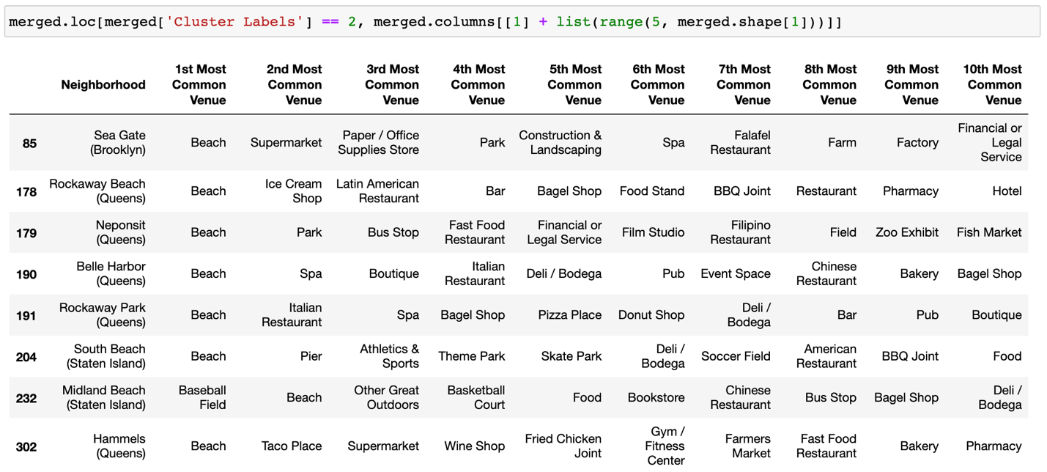
BLUE CLUSTER (2)
Beaches

Slide 15
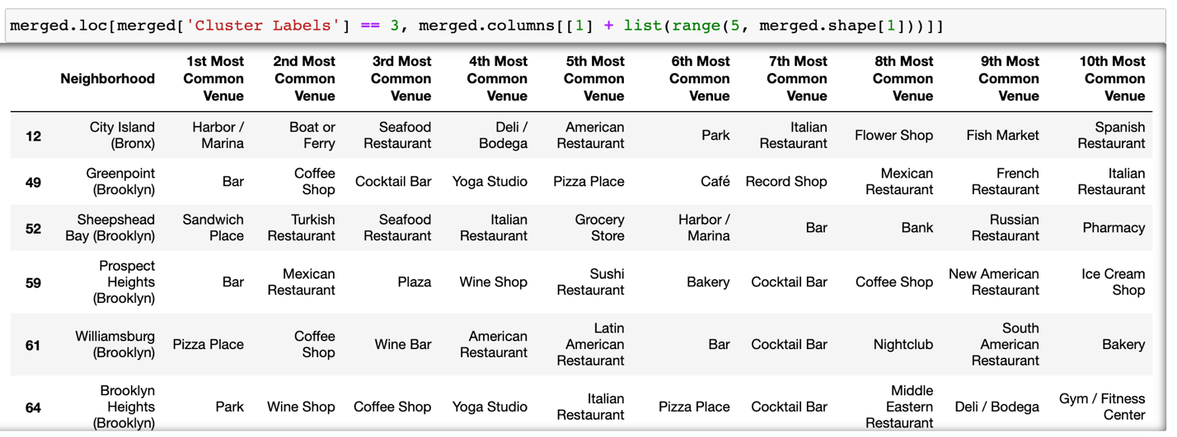
GREEN CLUSTER (3)
Coffee Shops, Hotels & a variety of other venues

Slide 16
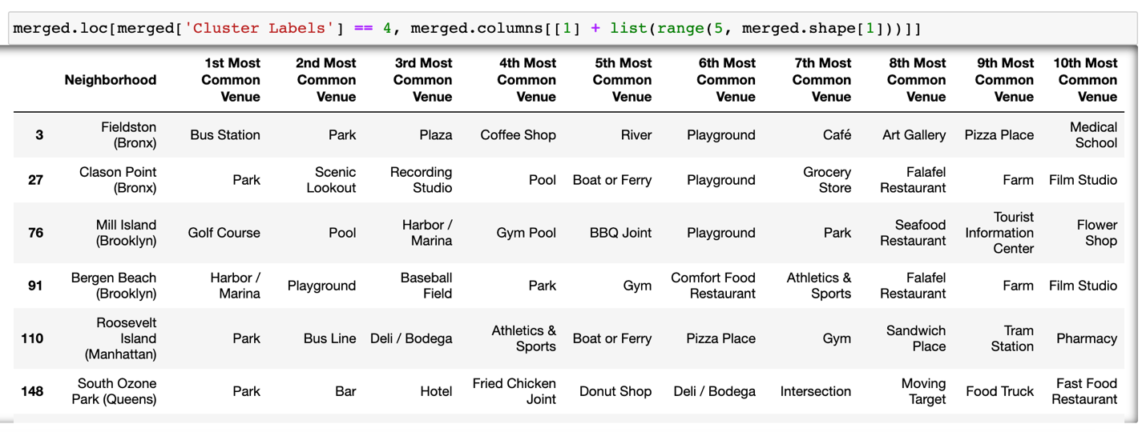
ORANGE CLUSTER (4)
Parks & Grocery Stores

Slide 17
SUMMARY
RED CLUSTER (0) - Pizza Places, Delis/Bodegas & Pharmacies
Most prevalent in NYC
Very few in London
PURPLE (1) - Pubs, Cafés, Coffee Shops, Grocery Stores & Parks
Most prevalent in London
None in NYC
BLUE (2) – Beaches
Only in NYC
GREEN (3) - Coffee Shops, Hotels & a variety of other venues
Located in the city centers of both NYC and London
ORANGE (4) - Parks & Grocery Stores
Located in the outskirts of both NYC and London

